Slide 1
Value Investing ML Model
Predicting future stock prices based on financial ratios
From domain analysis to demo application
ANALYZING
DESIGNING
REALIZING
MANAGE & CONTROL

Slide 2
Project Origin
I wanted to build a project combining investing and machine learning.
Inspired by Benjamin Graham's value investing philosophy.
Value investing = searching for companies worth more than their current market price.
Initial question:
To what extent can machine learning be used to predict future stock prices based on financial reports so that investors can identify potentially attractive investment opportunities?

Slide 3
Stakeholder & Expert Interview
Searched for real stakeholders in the investment domain.
Main stakeholder: Edwin Slaghekke, Head of Investments at Ambassador Vermogensbeheer.
Prepared expert interview: questions, conducted interview, created transcript.
Used to understand how professional investors analyze companies.
Identify
Stakeholder
Prepare
Questions
Conduct
Interview
Analyze
Insights

Slide 4
From Classification to Prediction
First idea: classify companies as undervalued, fairly valued, or overvalued.
Technical coaching revealed this was a weak ML problem.
The label 'undervalued' is not objective truth - it depends on interpretation.
A model would learn opinions behind labels, not objective reality.
Key lesson: a ML model needs a solid objective truth, measurable target variable.
Classification
(Rejected)
Regression
(Chosen)

Slide 5
Final Problem Definition
The stakeholder confirmed: estimating future stock prices is useful in their investment process.
"To what extent can machine learning be used to predict future stock prices based on financial reports so investors can identify potentially attractive investment opportunities?"
Target: Future Adjusted Close price, 12 months ahead
Problem type: Supervised Regression
Financial Ratios
at time t
Stock Price
at t + 12 months

Slide 6
Scope and Risks
The model is NOT financial advice.
It should be used as a screening or filtering tool.
Cannot predict black swan events (pandemics, wars, crises, management changes).
Qualitative factors (management quality, competitive advantage, sentiment) are out of scope.
Main risk: users may overtrust the model.
Overreliance
Black Swan
Events
Data
Limitations
Human
Judgement

Slide 7
Data Requirements & Source
Selected quantitative financial indicators based on expert interview:
Adjusted Close | Volume | Market Cap | P/E | P/S | P/B | P/FCF | EV/EBITDA | EV/Sales | Book to Market Value | Operating Income/EV | Altman Z Score
Compared sources: SEC Edgar, Kaggle, SimFin
SimFin selected: structured US/EU market financial ratios + share price history
Original dataset: ~22 million rows
SEC Edgar
Kaggle
SimFin

Slide 8
Baseline Model / Iteration Zero
Created a baseline model in Jupyter Notebook.
Dataset too large - reduced to most recent 3 years.
Aligned with stakeholder: does not focus too far back in time.
Inspected missing values, strange repeated values, and outliers.
Baseline gave a reference point for later improvements.
Jupyter
Notebook
Baseline
Model
First
Metrics

Slide 9
Data Cleaning & Preprocessing
Spent more time understanding missing and extreme values before removing them.
Used time series checks, frequency analysis, and domain reasoning.
Cleaned based on what values could mean financially (not random deletion).
Selected companies with at least 90% complete data.
Target variable: shifted future stock prices one year forward.
Feature engineering: One year of usable rows is lost due to 12-month forward shift.
Dataset from 22 million rows → 900.000 rows.
Raw Data
Cleaning
Completeness
Filter
Target
Engineering

Slide 10
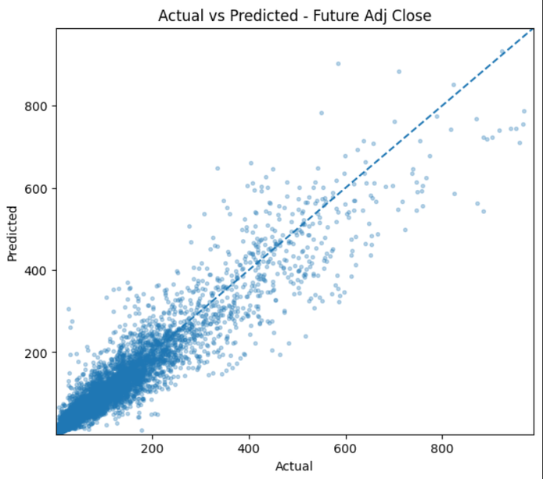
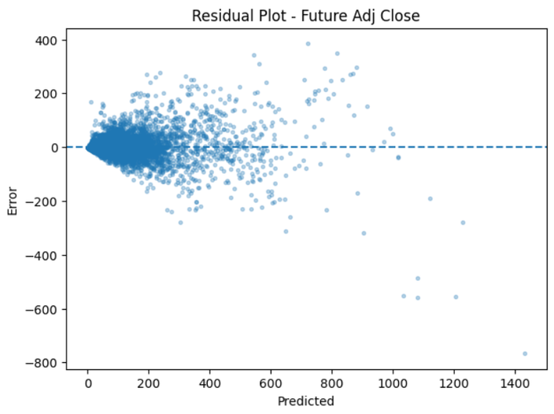
Model Training & Evaluation
Trained regression models to predict Future Adjusted Close price.
Also explored Price Change and Price Change % (needs further investigation).
Evaluation metrics: R-squared, RMSE, MAE, error plots, predicted vs actual plots.
Final model improved over baseline - better cleaning added value and target variable engineering.
Baseline R2 : 0.2668905
Final Model R2: 0.892099
Baseline RMSE: 78
Final Model RMSE: 38.611335
Baseline MAE: 586
Final Model MAE: 19.312589

Slide 11
Manage & Control / Explainable AI
Transparency
Explainability
Transferability
Uses understandable
financial ratios as inputs explained in domain analysis, and data requirements.
Notebook, model files,
Python script, requirements.txt, .NET app,
README included
Full documentation from
dataset to deployment

Slide 12
Demo Application & Conclusion
Built a .NET 8 Razor Pages web application with Bootstrap.
User can manually enter financial values or load example data.
C# app calls Python script that loads trained Joblib model.
.NET App
Python Script
Joblib Model
Prediction
Returns predicted Future Adjusted Close price.
ML can support value investing as a screening tool - not replace professional judgement.
"The most important learning was that good analysis and design made the model development more reliable."

